Slide 2

What’s new in F12 for Project Spartan
3-638
Microsoft Edge
Andy Sterland
@AndySterland | Andy.Sterland@microsoft.com
Senior Program Manager, Visual Studio, Web Diagnostics

Slide 3
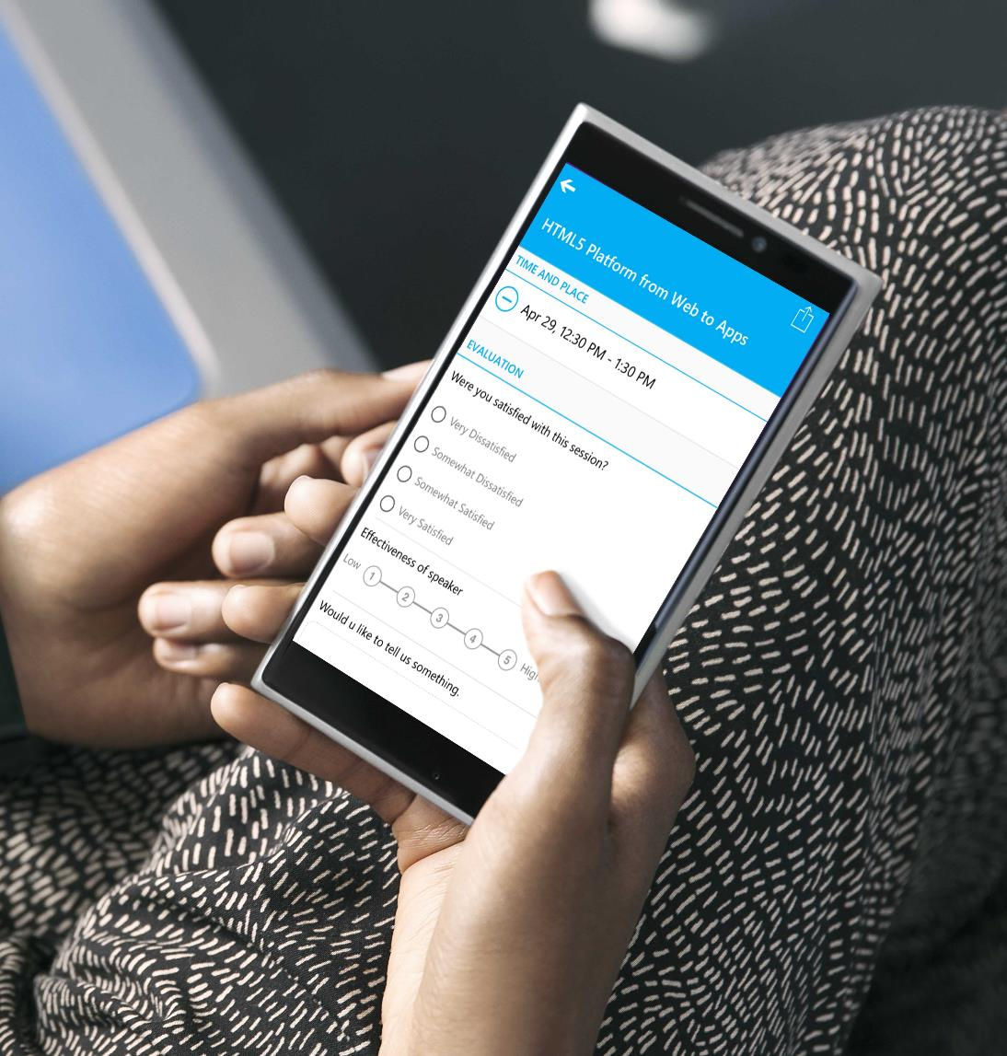
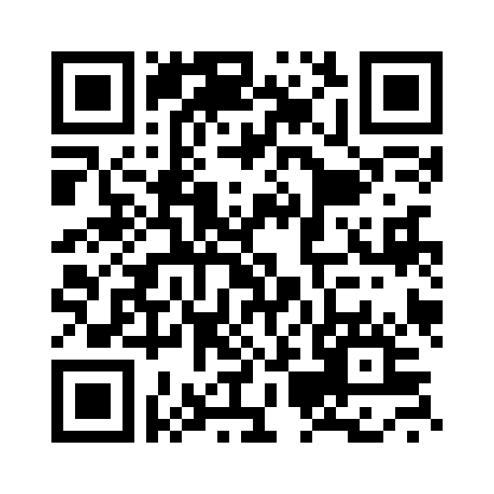
Submit an evaluation for each Breakout Session you attend.
BE ENTERED INTO THE DAILY PRIZE DRAWING!

Slide 4

F12

Slide 5
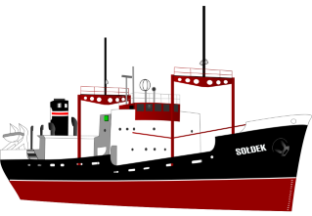
F12 Focus for Win10
Use Microsoft Edge to finish turning F12 around and get her going in the right direction
Notes:
Public domain image from: https://openclipart.org/detail/2812/soldek

Slide 6
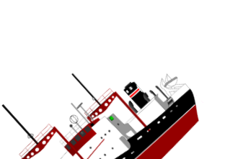

The Road Ahead
Tools for IE11 on Win10+ are frozen
Full steam ahead for Microsoft Edge
Notes:
Public domain images from:
https://openclipart.org/detail/2812/soldek

Slide 7



Browser Tools – A lot in common
DOM Inspection
Style Tracing
Computed Properties
Layout View
Color Picker
Debugger
Breakpoints
Watches
Console
Console API
CPU profiling
Style profiling
Network tracing
Heap snapshots
Snapshot diffing
Auto completion
Inspect element
Pretty printing
The 80% Case
So, so many tools in the tool box
*Not to scale or remotely mathematically sound!

Slide 8
Browser Tools – A little unique
Network throttling
Device emulation
Pseudo elements
Edit and continue
Paint correlation
CSS animation
Animation scrubbing
More…
3D view
Web audio editor
Animation
Shader editor
Reflow event logging
Responsive design mode
Lots of extensions
More…
TracePoints
Statement level JS
Just my code
Find references
Set next statement
Track changes
TypeScript colouring
More…

Slide 9

Notes:
Dragon from: https://openclipart.org/detail/1057/ddraig
Public domain

Slide 10
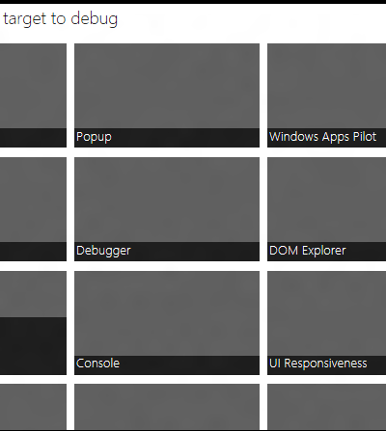
F12 against IE anywhere (locally..)
C:\Windows\System32\F12\F12Chooser.exe

Slide 11
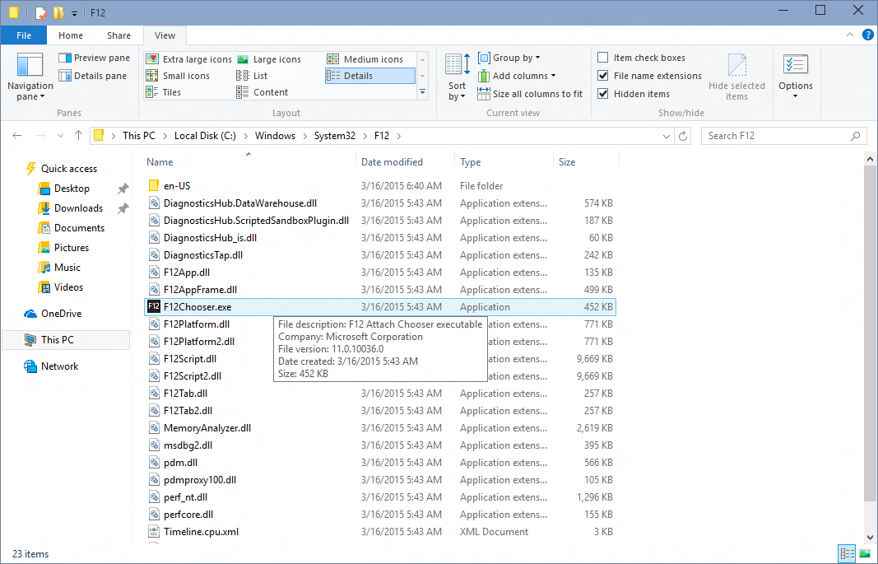
Located at: C:\Windows\System32\F12\F12Chooser.exe

Slide 12
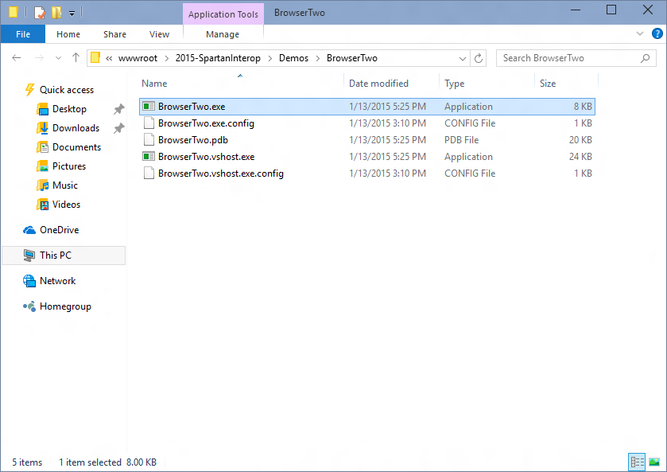
Launch the app you want to debug (winforms, win32, wpf)

Slide 13
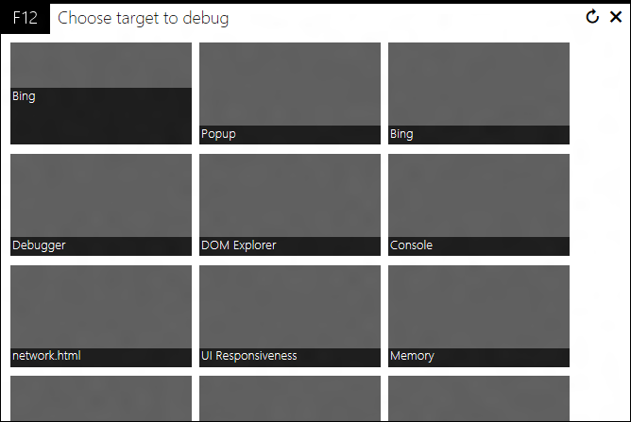
You’ll get something like this with a tile for each app you can debug

Slide 14
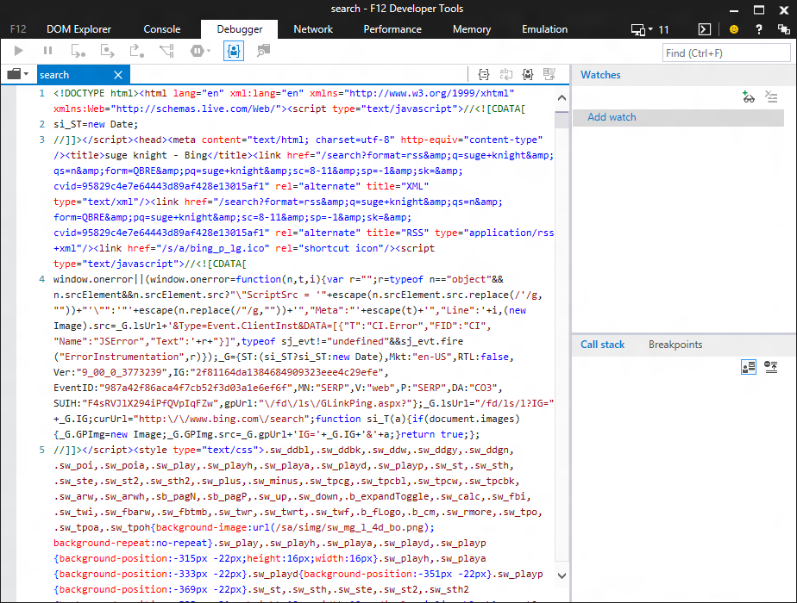
Launches F12 against the app…

Slide 15
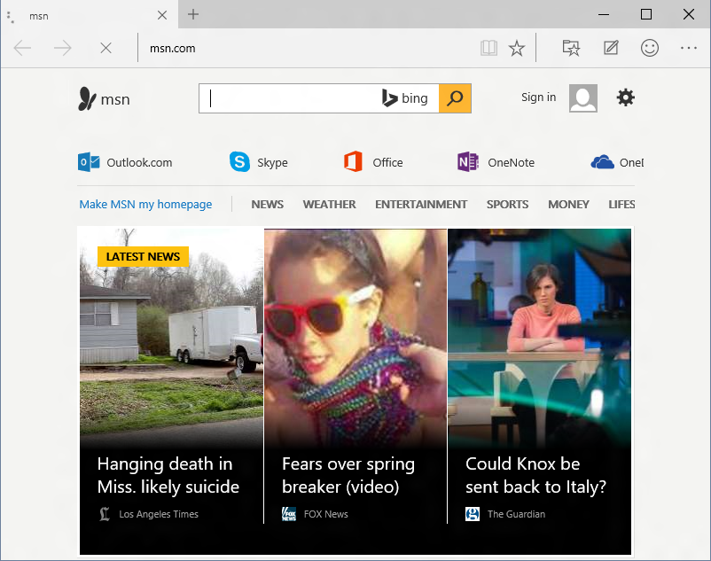
Works for Project Spartan too!
(It’s going to be your best bet for the preview flight)

Slide 16
F12 Chooser also works against apps that multiple web instances

Slide 17
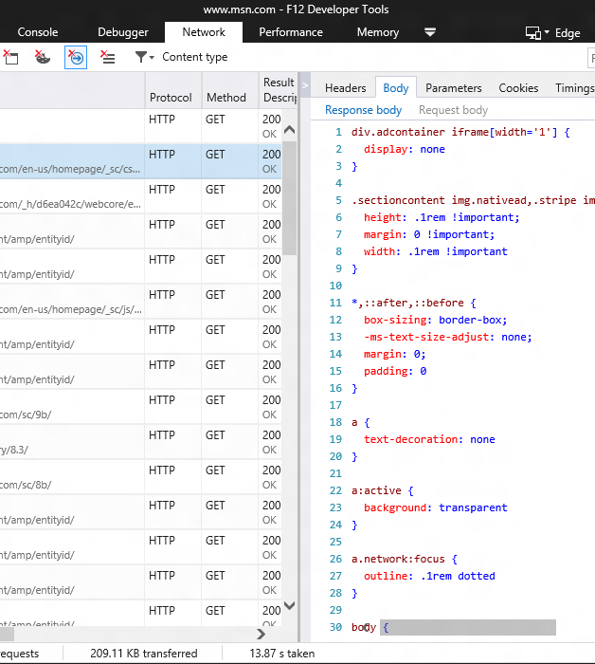
New network tool

Slide 18
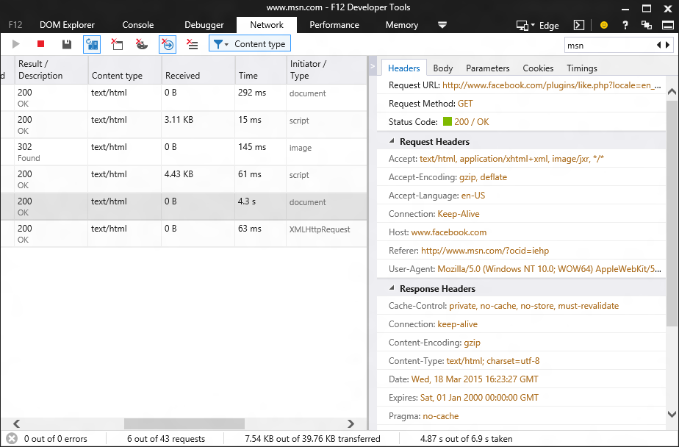
Brand new tool
(built in HTML & JS)

Slide 19
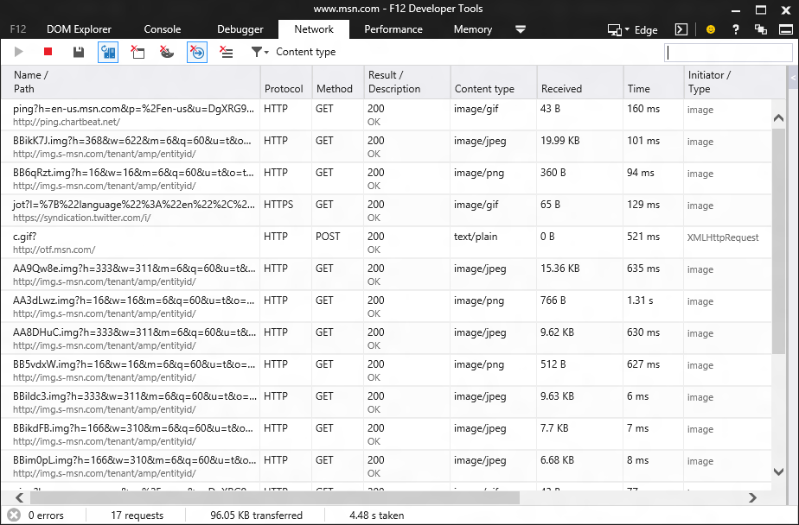
Recording start by default

Slide 20
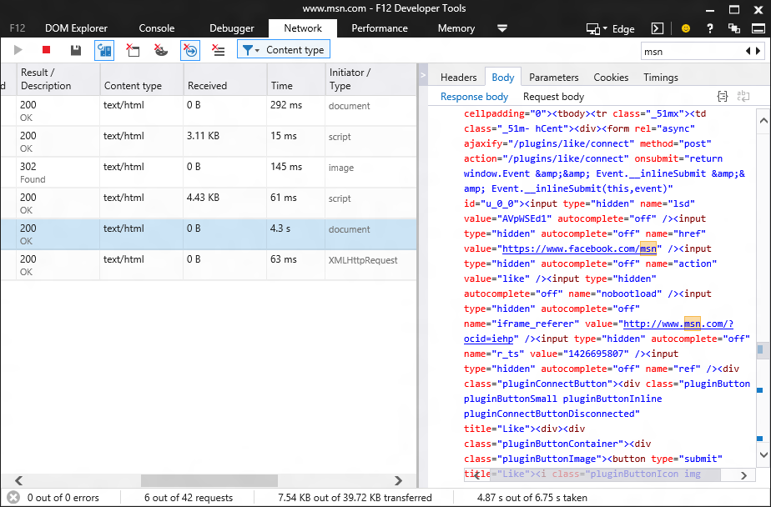
Search all network data

Slide 21
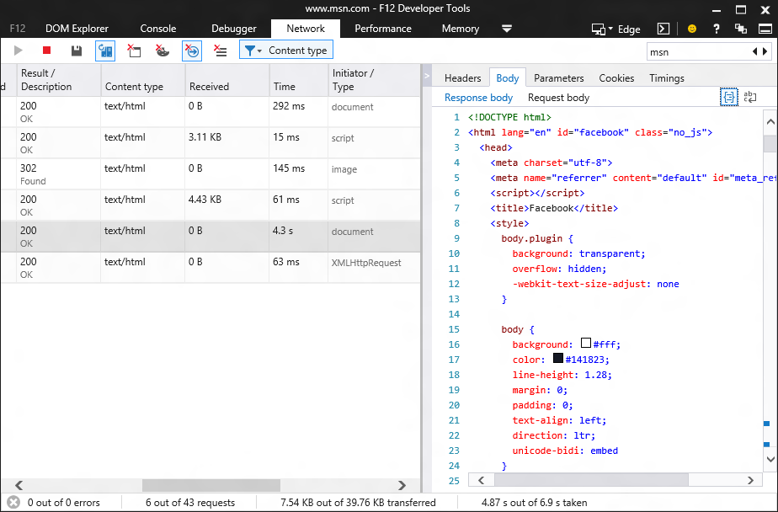
Pretty printing for common file types (including JSON!)

Slide 22
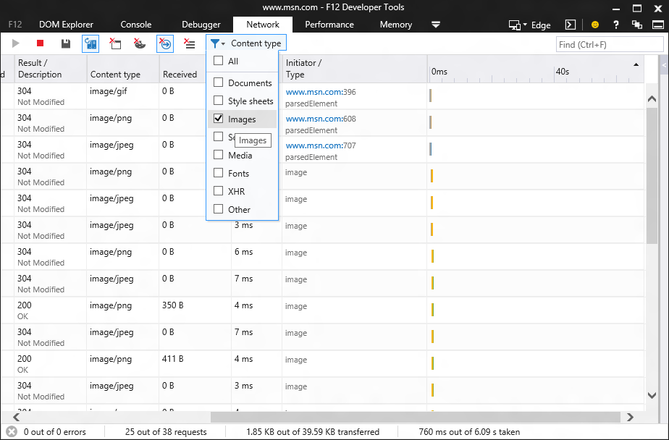
New: Type filtering

Slide 23
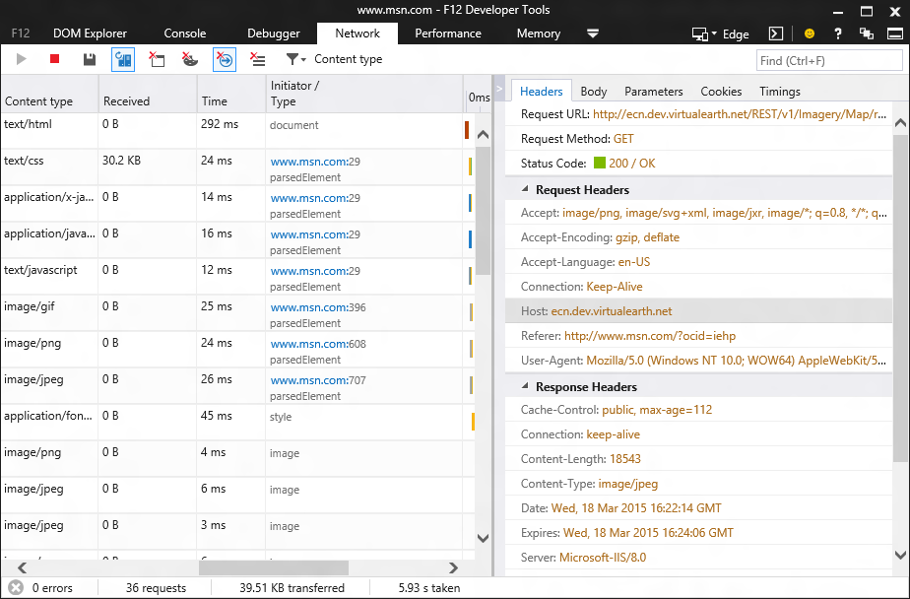
Download initiator

Slide 24
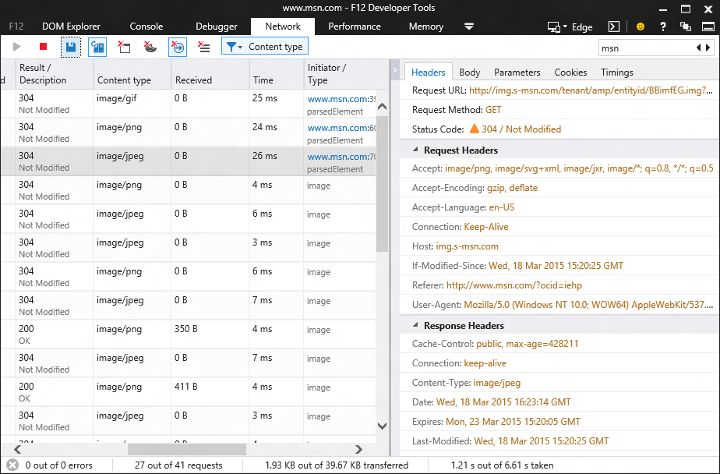
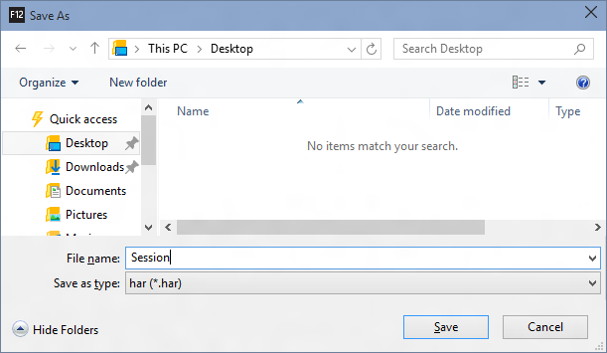
Export to HAR

Slide 25
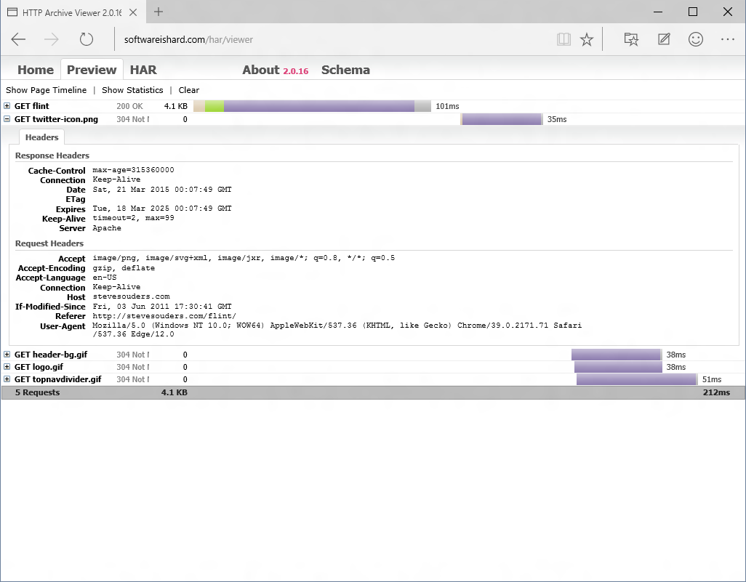

Slide 26
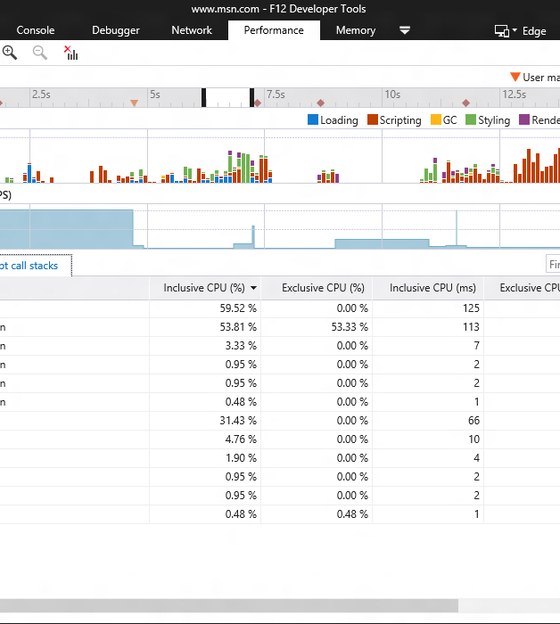
Updated performance tool (nee UI responsiveness tool)
new name
user marks
new cpu profiler

Slide 27
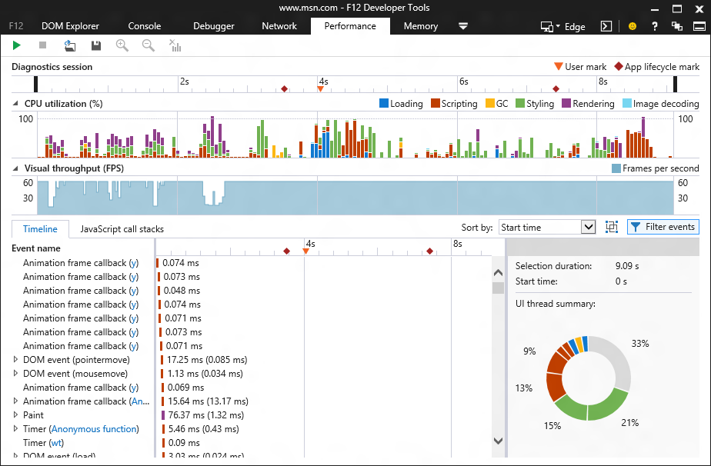
UI responsiveness tool is now named “Performance”

Slide 28
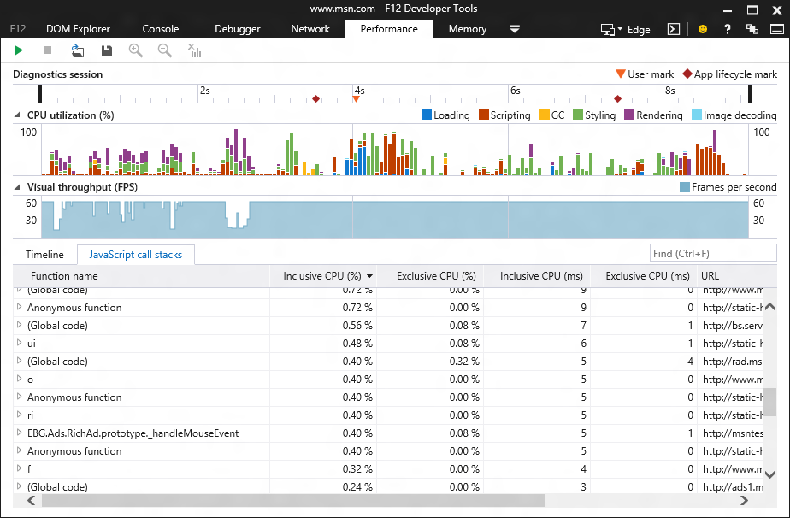
JavaScript profiler now integrated into performance tool (sampled so way less overhead than the old profiler)

Slide 29
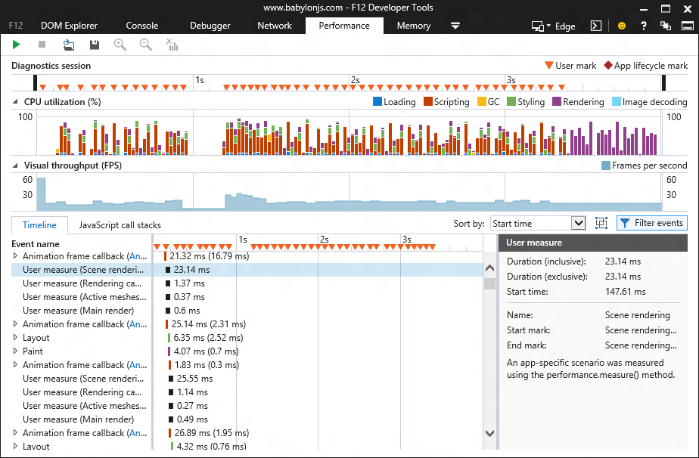
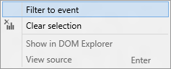
User marks help you tailor the profiler view ()

Slide 30
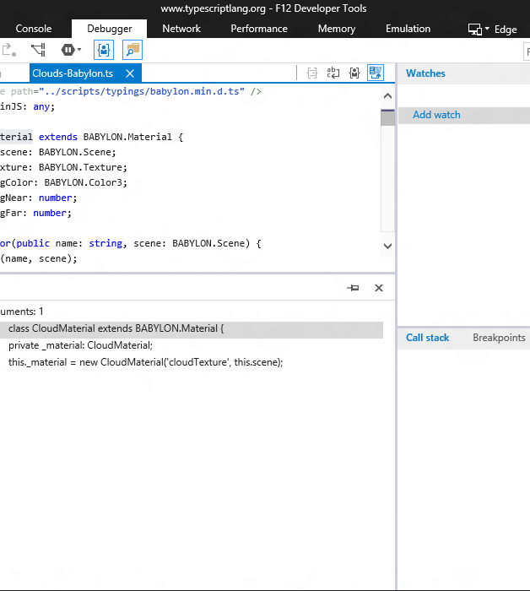
Making hard things easier
better source navigation
sourcemaps for css
pretty print anything

Slide 31
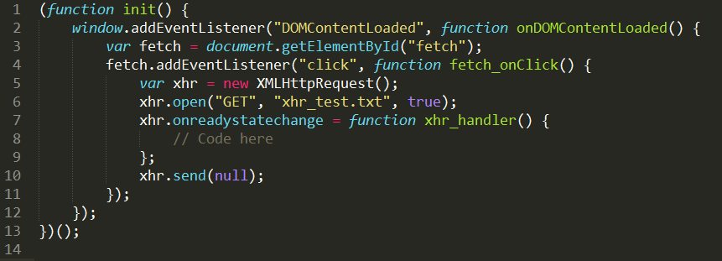
New async operation “addEventListener” for click
Global Code
onDOMContentLoaded
New async operation “addEventListner” for DOMContentLoaded
Global Code
init
New async operation “onreadystatechange”
Global Code
fetch_onClick
Finally we break in the debugger…

Slide 32
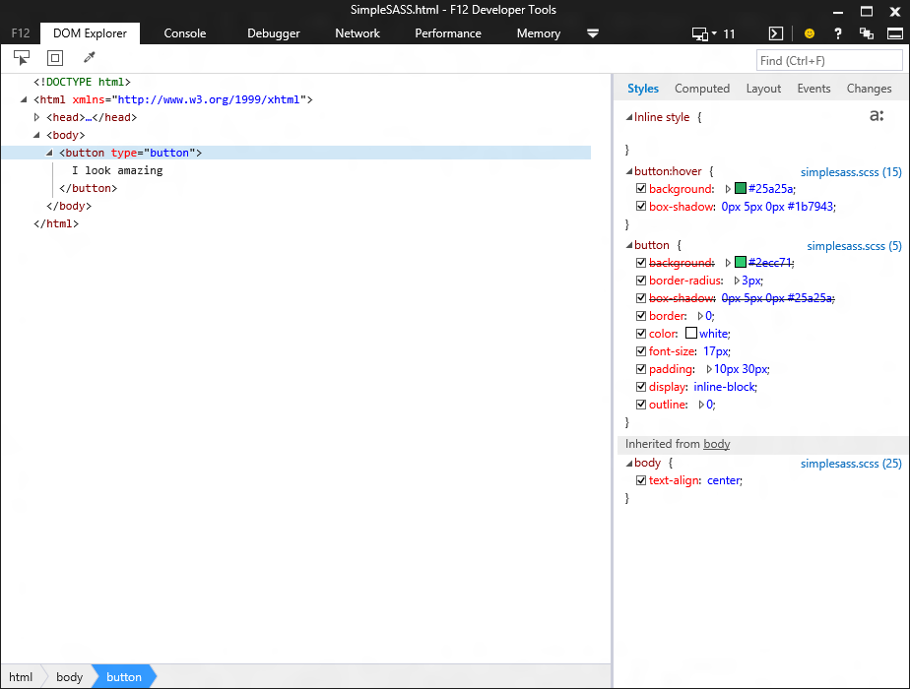
Source mapped style links in the DOM Explorer

Slide 33
Source mapped CSS files in the debugger (complete with pretty colors for LESS and SASS)

Slide 34
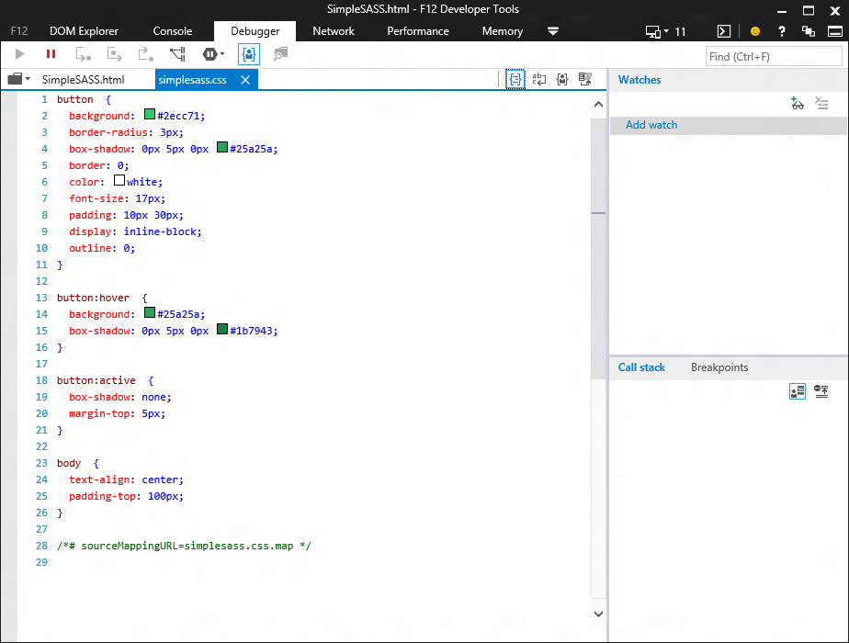
Pretty print CSS

Slide 35
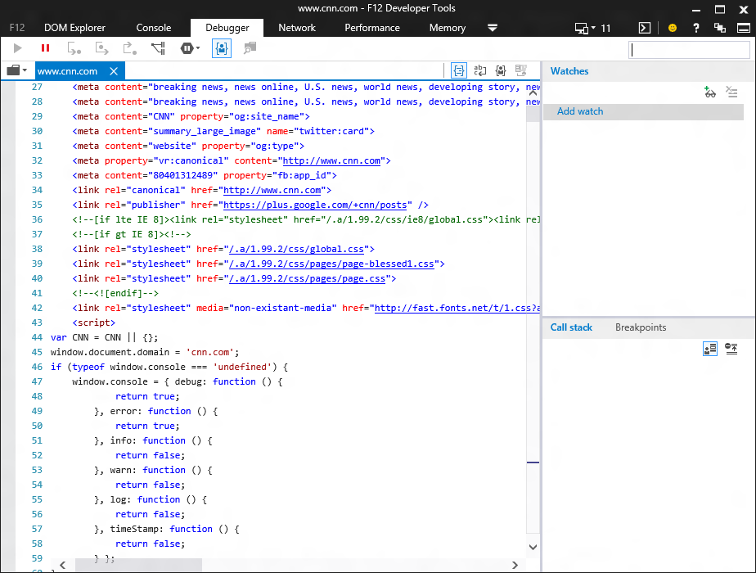
Pretty print HTML (including inline <script> and <style>)

Slide 36
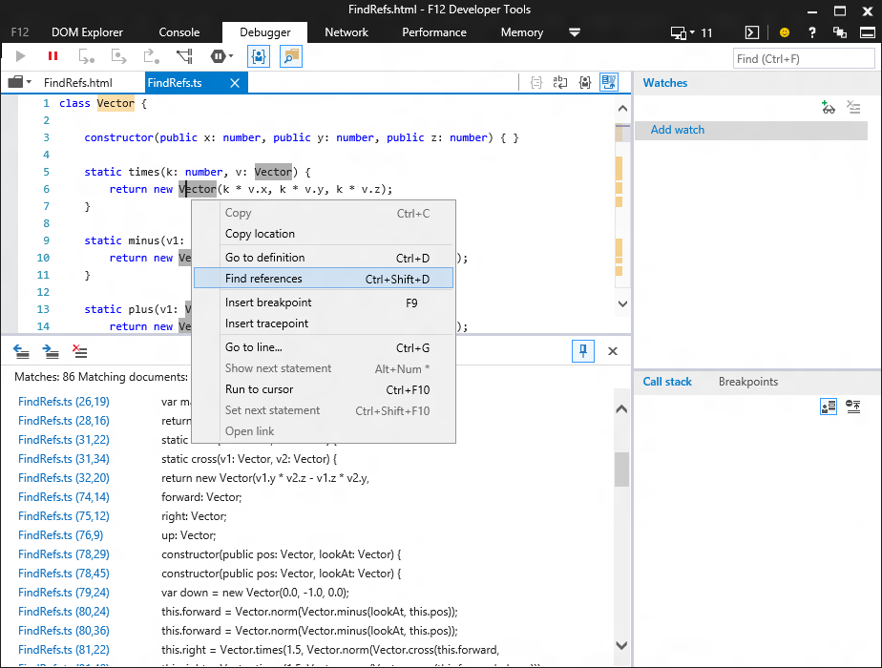
Bringing powerful language features from VS to F12
(go to definition and find references works like a charm for TypeScript)

Slide 37

Adding experimental features
javascript editing
css editing
cookie inspection
local and session storage

Slide 38
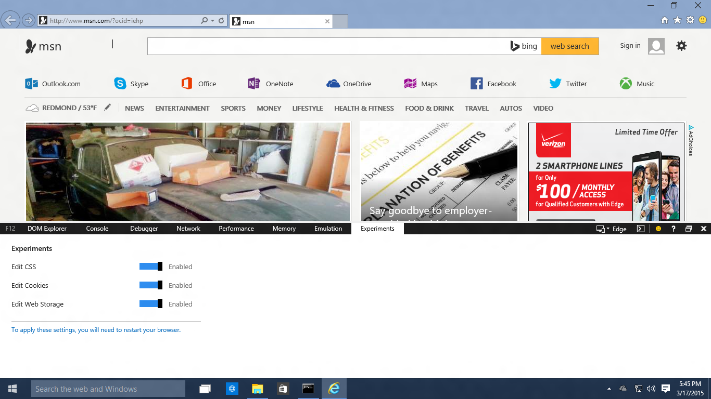
It’ll look something like this…

Slide 39
Join in and help build better tools for you
uservoice.modern.ie
connect.microsoft.com
github.com/microsoft
@IEDevTools

Slide 40
Evaluate this session
Your feedback is valuable!

Slide 41
?
QUESTIONS

